Slide 1
ICS 432 – 01 Distributed and Cloud Computing Fall 2021
Instructor: Thanaa Ghanem
thanaa.ghanem@metrostate.edu
Lectures 10
October 30, 2021

Slide 2


Introduction
There has been transition from computation-intensive to data-intensive applications:
data is produced in massive amounts by large sensor networks, simulations, and social networks.
Efficiently extracting, interpreting, and learning from very large datasets requires a new generation of data management technologies.
In this part of the courses, we will cover the basics of the following big data management approaches:
Hadoop ecosystem as de facto big-data-management system, and
NoSQL systems

Slide 3
What is Data?
Data is raw information or facts that become useful information when organized in a meaningful way.
Example 1: Student Data
J0100, Jones, Tammy, R, 1817, Eagleridge Circle, Tallahassee, FL, 32811
PE100, Perez, Jorge, C, 951 Rainbow Dr, Clermont, FL, 34711
MA100, Marsh, John, A, 1275 West Main St., Carrabelle, FL 32320
SM100, Smith, Mike, 428 Markson Ave, Eastpoint, FL, 32328
J0101, Johnson, Lisa, M, 764 Johnson Place, Leesburg, FL, 34751
NG100, Nguyen, Ni, M, 688 4th Street, Orlando, FL, 34158

Slide 4


Traditional Data Management Applications
Common Properties and Requirements
Large data sizes
Various querying capabilities
Concurrent access
Data security
Data administration
University
Students, Courses, Registration, Grades
Airlines
Flights, Reservation, Schedules,
A Database Management System (DBMS) is a software package that is designed to store and manage databases
Digitized Data
Banking
Deposit, Withdrawal, All transactions
Retail
Stores, Prices, Quantities, Sales

Slide 5

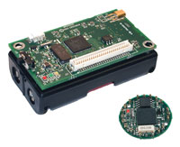



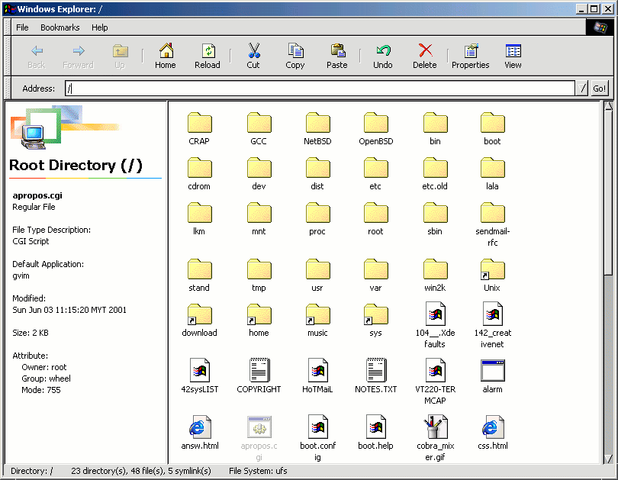








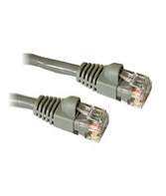






























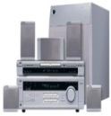



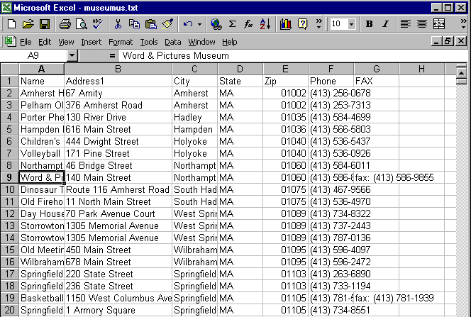




Data Sources Now

Slide 6
Big Data
Companies, organizations, and scientists have data that is too big, too fast, and too complex to be managed without changing tools and processes.
How much is big depends on the application domain.
Data units:
Value | Metric
1024 | KB | kilobyte
1024² | MB | megabyte
1024³ | GB | gigabyte
1024⁴ | TB | terabyte
1024⁵ | PB | petabyte
1024⁶ | EB | exabyte
1024⁷ | ZB | zettabyte
1024⁸ | YB | yottabyte

Slide 7
Big Data: What are the drivers?
Social Media:
Twitter: 517 million accounts, 500+M tweets/day
Facebook: 1.23B users, 3.2+B likes and comments/day
Web:
Web logs
Online retails
Cookies
Mobiles:
5.5 billion cell phones
800 million smart phones
Extended sensory data (geolocation)

Slide 8
(Big) Data is valuable
Google and Facebook make money by mining user data for revenue from advertisement
Financial firms analyze financial records, real-time transactions and current events for profitable trades
Medical records can be processed for better and cheaper health care
Roadways are monitored for traffic analysis and control
Social network data can be analyzed for discovering events

Slide 9

Notes:
Remove animation
[3] http://techcrunch.com/2012/12/18/god-bless-us-every-one/

Slide 10

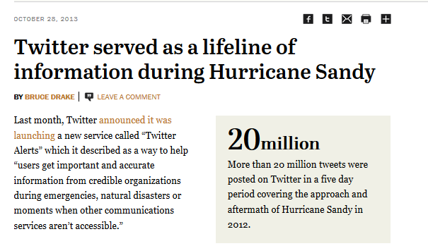
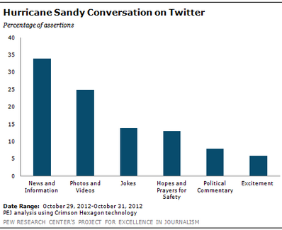
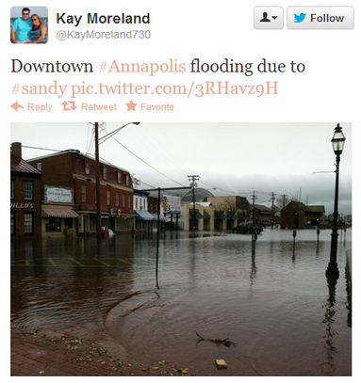
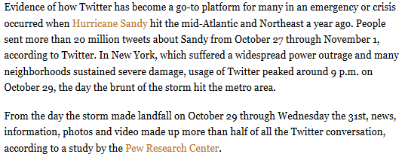

Slide 11
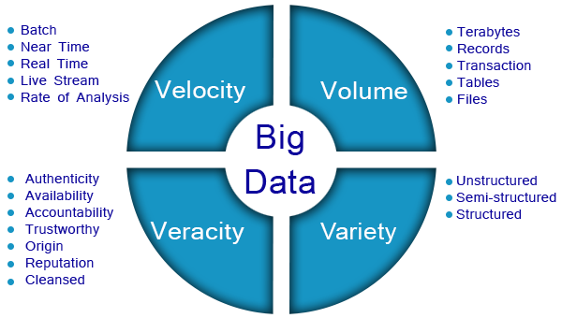
Big Data: What is the big deal?
The Four V’s of Big Data
Volume: the size of the data
Velocity: the speed of data generation and analysis
Variety: the diversity of sources, formats, and structures
Veracity: the uncertainty of the data

Slide 12
Studying Big Data
Two pathways:
Big Data Analytics:
The process of examining the data to uncover hidden patterns, unknown correlations and other useful information that can be used to make better decisions.
Related subjects: statistics, machine learning, data mining
Big Data storage and processing (i.e., infrastructure):
How to use computers to store and manage big data
Related subjects: computer architecture, operating systems, storage, and data management systems

Slide 13
Using Cloud Computing for Big Data Analytics
Advantages:
clouds support a broad range of big data technologies.
deploy the latest version of big data software in a short amount of time.
Elasticity and pay-per-use.
offer a broad set of policies, technologies, and controls to protect data, applications, and infrastructure.
Challenges:
privacy & compliance
service interruptions & latency issues
Although migrating big data solutions to the cloud presents some hurdles, the opportunities outweigh the challenges

Slide 15
Notes:
Grace Hopper is named the mother of Computer Science. She invented the first high level programming language and compiler.

Slide 16
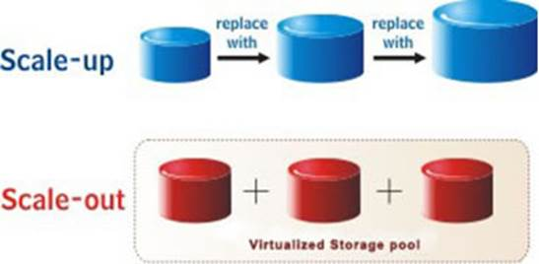
Large-Scale Computing: Scale up vs. Scale out

Slide 17
Issues in traditional Distributed System when working with big data
Programming complexity (keeping data and processes in sync).
Failure handling is not seamless.
Data bottleneck because of the finite bandwidth.
Conflict between consistency and availability of the data.

Slide 18
Distributed Systems problems (1/4): Complexity
Notes:
The goal of CORBA is to promote an object-oriented approach to building and integrating distributed software applications. An object model for building distributed applications. A common set of application programming objects to be used by the client and server applications.

Slide 19
Distributed Systems problems (2/4): Failure handling is not seamless
As you add more machines, the likelihood of a system failure increases
Assume a given machine has a 1% chance of failure on any given day
If you have one machine, how often are you expected to have one failure?
once every 100 days
If you have 100 machines in your distributed systems, how often are you expected to have a failure?
once every day
The problem become worse as you add more machines.
Add to that network failures!!
Failure handling should not be expensive.

Slide 20
Distributed Systems problems (3/4): Limited Bandwidth

Slide 22
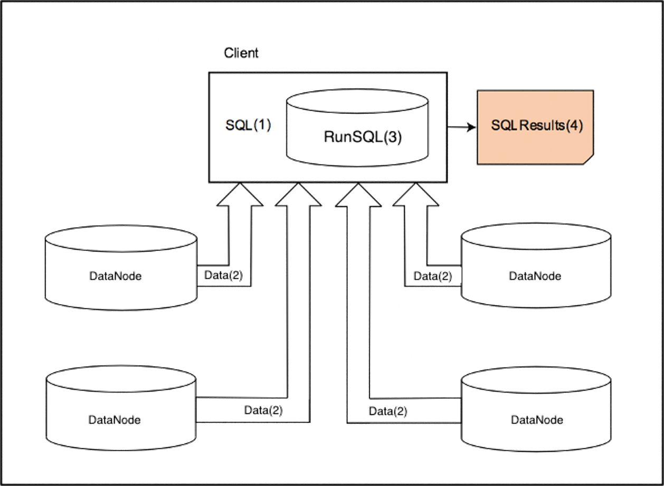
Example: Traditional execution of Distributed SQL
To run a SQL query:
The SQL code and the data needed
for the query must be residing on
the same machine
In a traditional network architecture:
Data moves to the computer that holds the code waiting for execution
Step 1 (SQL(1)): triggers the movement of data to the machine on which the query runs
Step 2 (Data(2)): represents the movement of data from each node to the client machine
Step 3 (RunSQL(3)): the SQL code is executed on the whole dataset
The results are generated in Step 4, SQLResults(4)

Slide 24
Distributed Systems problems (4/4): Consistency vs. Availability
Distributed systems are always prone to failures because:
a node failure may fail due to hard disk crash
network communication failure
loss of connection between two nodes
The more nodes, the more likely the system will fail
Risk of failures: consistency and availability of the data can be affected
If the risk is unavoidable: a system must decide between consistency and availability

Slide 25
A new Approach to work with big data

Slide 26
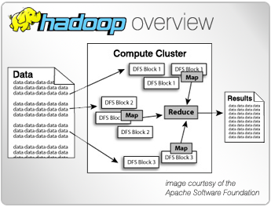
What is Hadoop?
A radical new approach to distributed computing that is optimized for big data applications.
Open-source
Massively scalable
Automatically parallelizable
Based on work done by Google:
2003: Distributed file system paper
2004: Map Reduce paper
Core concept:
Processing is performed on a cluster that includes hundreds/thousands of commodity hardware

Slide 27
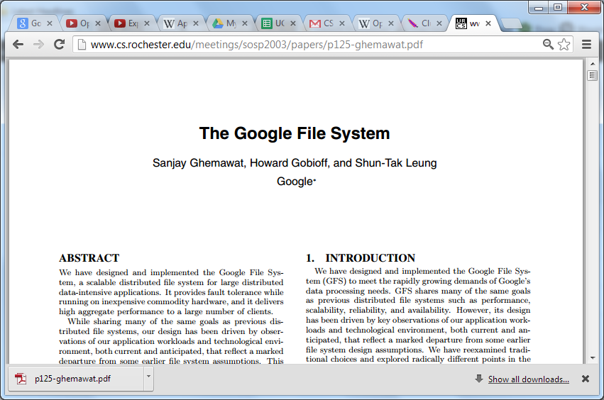

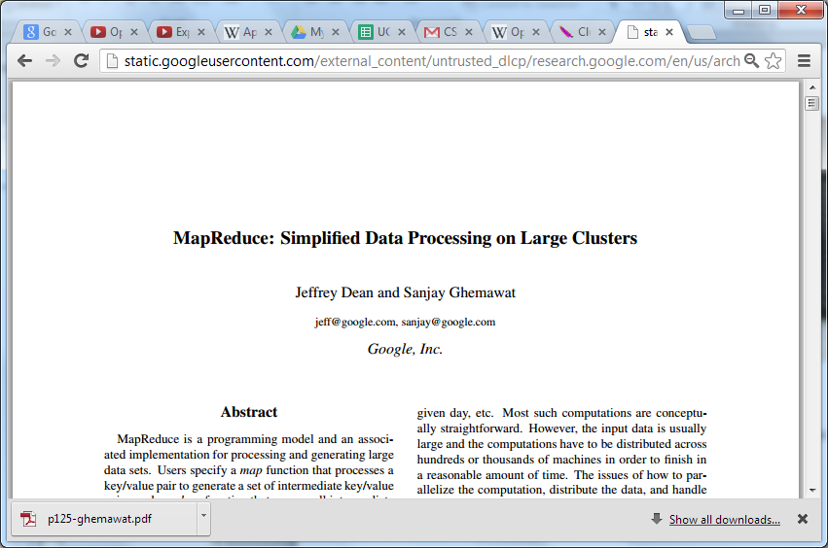

Basic Components of Hadoop

Slide 28
Hadoop’s Core Concepts
Data is spread among machines in the cluster in advance
Computation happens where the data is stored, wherever possible
Data is replicated multiple times on the system for increased availability and reliability
Applications are written in high-level code
Developers do not worry about data distribution, network programming, dependencies, or failures.
Cluster nodes talk to each other as little as possible
Developers should not write code that requires communication among nodes

Slide 29

The Hadoop Ecosystem
Source: https://www.dotnettricks.com/learn/hadoop/apache-hadoop-ecosystem-and-components

Slide 33

A Brief History of Hadoop
2000: The Apache Nutch Project:
Open-source web crawler and search engine
Created by Dough Cutting and Mike Cafarella
Challenge: searching and indexing the web is expensive!
They estimated that a billion-page index = $500K in hardware
Operating cost is $30K/month

Slide 34
A Brief History of Hadoop (continued)
2003: The Google File System paper is published
Symposium of Operating Systems Principles Conference (SOSP 2003):
Highlights of the Google File System:
Distributed file system
Its design is driven by observations of Google’s application workloads
Marked departure from some earlier file system assumptions
Built on top of low-cost, commodity storage nodes

Slide 35
A Brief History of Hadoop (continued)
2004: Google published another paper “Map-Reduce: simplified data processing on large clusters” :
Symposium on Operating System Design and Implementation (OSDI 2004)
2005: Doug and Mike re-implemented map-reduce and GFS in open-source to power Nutch.
2008:
Apache elevates Hadoop to a top-level project
Yahoo! Announces that production search engine is running on a 10,000 node Hadoop cluster

Slide 36
A Brief History of Hadoop (continued)
Hadoop has been steadily maturing over the years
2013: Hadoop 2 introduces significant highlights from Hadoop 1:
YARN (Yet Another Resource Negotiator): a new resource management system
HDFS improvements for high availability
Security and stability
Although map-reduce is still important to computing on Hadoop, other tools and frameworks are leveraging YARN to allow for more flexibility in application development.
Hadoop is becoming a more general operating systems for distributed applications

Slide 37
What patterns makes a problem Hadoopable?
Huge volume and variety of data
If all the data fits in one single machine, then process the data within that single machine
Batch Processing
Not ad-hoc queries
Parallelizable problems

Slide 38
Hadoop’s Big Ideas
Big Idea 1: Scale “out”, not “up”
Big Idea 2: Hide System-level details from the application developer
Big Idea 3: Fault tolerance is integral to the system
Big Idea 4: Move Processing to data
Big Idea 5: Avoid Random Access
Big Idea 6: Seamless Scalability.

Slide 39
Big Idea 1: Scale “out”, not “up”
For data-intensive workloads, a large number of commodity low-end servers (i.e, the scaling “out” approach) is preferred over a small number of high-end servers (i.e., the scaling ”up” approach).
The reasons are:
the cost of highly effective machines does not scale linearly.
The workloads are beyond the capability of of any single machine, no matter how powerful.
Communication cost becomes is the dominating factor.
hence an efficient solution must minimize the communication cost.

Slide 40
Big Idea 2: Abstract System-level Details
Parallelism is not a new idea. It exists in:
Hardware layer (multicore - parallel processors)
Software (using threads)
However, writing parallel code used to be hard
Hadoop is handling more data using parallelism but applications are written at a high-level are not concerned with network programming, synchronization, or data flaw.
a developer focuses on analytics, not distributed programming

Slide 41
Why parallel programming is hard?
How do we assign work units to workers?
What if we have more work units than workers?
What if workers need to share partial results?
How do we aggregate partial results?
How do we know all the workers have finished?
What if a worker dies?
Traditionally, more work was spent on developing the distributed application not on the analytics that is needed to solve the problem

Slide 42
Big Idea 3: Fault tolerance is integral to the system
Failures are the norm rather than the exception, why?
Using commodity hardware makes the probability of failures higher.
Suppose a cluster is built using machines with a mean-time between failures of 1000 days.
For a 10,000 server cluster, there are on average 10 failures per day!
In a fault tolerant system, automatics error detection and recovery are integral to the system
Redundancy/Replication keeps data and computations safe
However, more storage is needed than the expected size of the files
Example: if the cluster needs to process 1TB of data, a replication factor equal to 3 suggests that the cluster should be expanded to store no less than 3TB

Slide 43

Big Idea 4: Move Processing to Data
Avoid data transfer hence saving bandwidth
Data Local Computing:
Data is distributed and stored on nodes, and those nodes attempt to perform work on the data they have rather than transfer it across the network.
Each task only operates on single block of data and only knows about the data it operates on.
Master nodes are used to allocate work and manage jobs

Slide 44
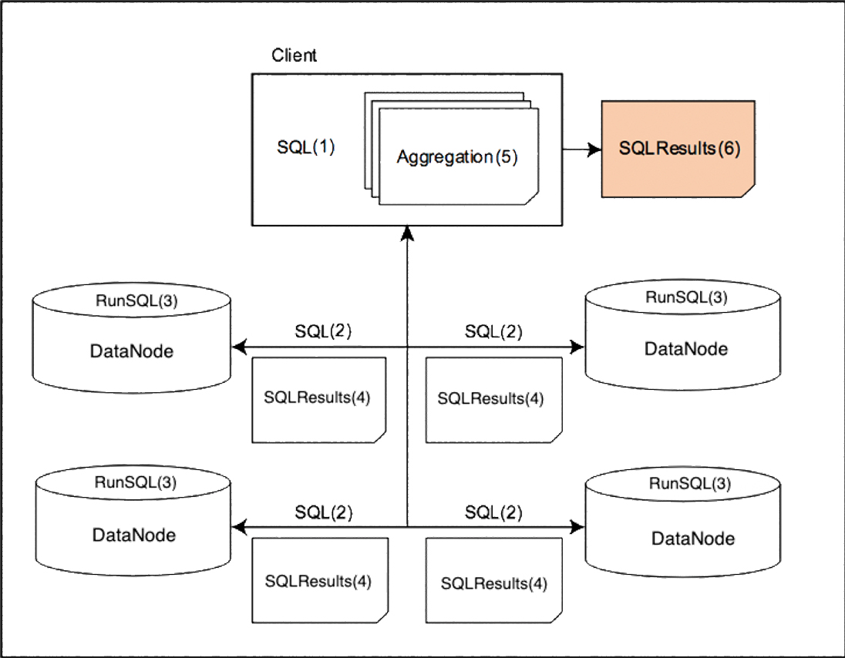
Example: Moving code to data
Step 1: triggers copies
of the SQL
Step 2: moves SQL copies to data nodes
Step 3 (RunSQL(3)): each SQL copy is executed
using the data stored in each node to
generate partial results
Step 4 (SQLResults(4)): the results are sent to the client
Step 5 (Aggregation(5)): aggregation process occurs.
Step 6 (SQLResults(6)): results are generated.
Avoids network traffic congestion
Requires an adjustment to the data processing algorithms
the distributed data processing algorithm must also include the aggregation layer.

Slide 45
Big Idea 5: Avoid Random Access to files
Motivating example:
1 TB database containing 10¹⁰ -100 bytes records
Assuming random access:
each update takes ~30MS(seek, read, write)
updating 1% of the records takes ~35 days
Assuming sequential access: 100MB/s
Reading the whole dataset and rewriting the records takes 5.6 hours
Hadoops is optimized for reading large amounts of data:
Hadoop’s disk block size is very large (128MB) when compared to block size of Unix and windows OS (4 KB).
minimize the impact of disk latency

Slide 46
Big Idea 6: Seamless Scalability
Hadoop’s scalability is implemented in two dimensions:
Data: given twice the amount of data, the algorithm should take at most as twice as long to run
Resources: given a cluster twice the size, the same algorithm should take no more than half as long to run
In Hadoop, the map-reduce programming framework maintains a clear separation between what computations need to be done and how these computation is performed in a cluster.
The map-reduce framework approached ideal scalability.

Slide 47
BUT not all problem are Hadoopable
Hadoopable problems are characterized by:
Huge volume and variety of data (at least terabytes or petabytes)
If all the data fits in one single machine, then process the data within that single machine
Batch Processing: not ad-hoc queries
Parallelizable problems

Slide 48
Overview of a Hadoop Cluster

Slide 49
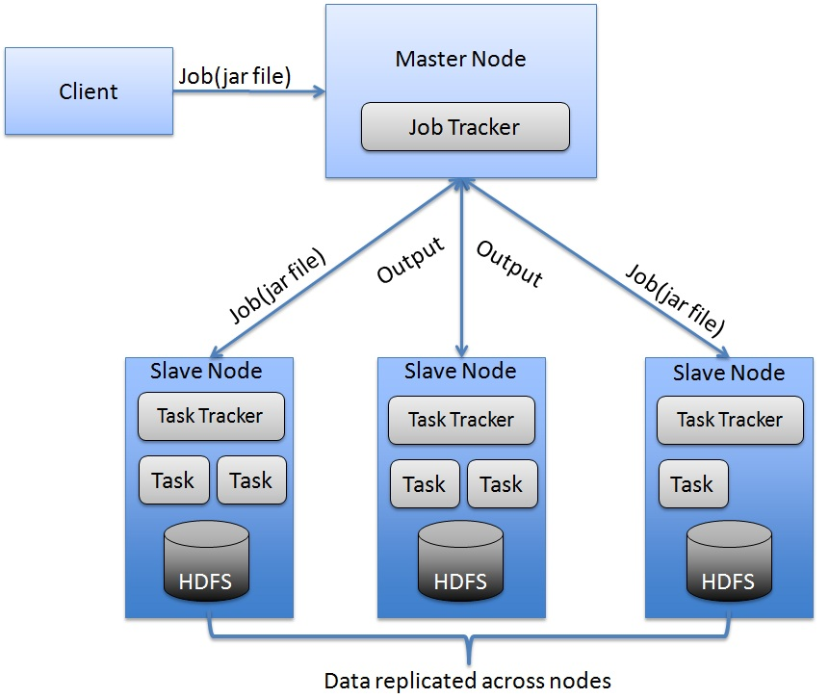
Typical Hadoop Cluster Architecture

Slide 50
Steps to process a large volume of data using Hadoop
Load the data to HDFS on multiple machines
Key-value pairs
On each machine, extract/transform something of interest from each data record
Map
Shuffle intermediate results between the machines
Sort & Shuffle
Aggregate intermediate results
Reduce
Store end results in HDFS

Slide 51
Definitions
Hadoop node:
An individual machine in the cluster that is running HDFS and YARN
Hadoop cluster: a set of nodes:
one master and several slaves.
A cluster can have a single node or many thousands
A cluster scales linearly:
Every node you add, you gain more capacity and performance

Slide 52
Types Nodes in a Hadoop Cluster
There are two types of nodes that are differentiated by which processes run on them:
Master nodes: one per cluster, run the global management process
Storage -- HDFS: NameNode
Processing – YARN : Job Tracker
Slave nodes: local data and application processes
Storage -- HDFS: DataNode
Processing – YARN: Task tracker

Slide 57
Hadoop’s Daemon Processes
HDFS processes:
NameNode (NN): (master) contains metadata for HDFS operations
Secondary NameNode: performs housekeeping tasks for HDFS like maintaining a log (this is not a backup of the name node)
DataNodes (DN): (worker or slave) stores and manages HDFS blocks on a node. Reports the health and status of an individual data store.
YARN processes:
Resource Manager: (master) allocates and monitors processing jobs for Map Reduce and other applications
Application Master: (master) every application is assigned an application master that coordinates a particular application as scheduled by the Resource Manager
NodeManager: (worker or slave) runs and manages processing tasks on an individual node
Notes:
Daemon is a software program that is always on and running on the background nodes of the cluster
Each node had Data Node and Node Manager
Application Master is alive with an application

Slide 58
Hadoop’s Daemon’s (continued)
Each of these processes runs inside its own Java Virtual Machine (JVM)
Each daemon has its own system resources and is managed independently of the other daemons by the operating system.
Small clusters (~20-30 nodes) usually have one or two master nodes that run NameNode, Secondary NameNode, Resource Manager and Application Master(s).
Larger clusters have one machine per master deamon and include Master redundancy.
All nodes in the cluster run DataNode and NodeManager

Slide 59
Hadoop Installation Modes
Hadoop can be configured to run in one of three modes:
Standalone mode
HDFS is not utilized in this mode.
Local file system is used for input and output
This mode is used for debugging purpose
Pseudo-distributed Mode (single node cluster):
Pseudo distributed cluster is a cluster where all daemons are running on one node
Used for real Code to test in HDFS
Fully Distributed Mode (multiple node cluster):
Data is distributed across many nodes.
Different Nodes will be used as Master Node / Data Node / Job Tracker / Task Tracker

Slide 60
Pseudo-distributed Mode
In “Pseudo-distributed Mode”, a single machine runs all Hadoop Daemons in their respective environments as though they were on a cluster.
In this mode, the benefits of distributed architecture are not realized, but it is an excellent environment to develop analytical jobs before submitting them to the cluster on larger data sets.

Slide 61
Data Storage in Hadoop

Slide 62
Roadmap
File System in centralized computing
Distributed File System
The Google File System
Hadoop Distributed File System (HDFS)

Slide 63
File Systems in centralized computing
A file is organized as a linear array of bytes or blocks
the internal file structure is imposed by the application
A filesystem is the methods and data structures that an operating system uses to keep track of files on the hard disk
A File System is responsible for mapping file names and offsets to disk blocks

Slide 64
Traditional Distributed (Network) File System (e.g., NFS)
Traditional Distributed (Network) File System is a file system, that supports sharing of files and resources in the form of persistent storage over a network.
Benefits:
Sharing:
Different users on different machines can read/write same files
Simplified administration:
One shared server to maintain and backup
Improve reliability

Slide 65
Google File System (GFS)’s Paper Abstract
“We have designed and implemented the Google File System, a scalable distributed file system for large distributed data-intensive applications”
“It provides fault tolerance while running on inexpensive commodity hardware, and it delivers high aggregate performance to a large number of clients”
“the largest cluster to date provides hundreds of terabytes of storage across thousands of disks on over a thousand machines, and it is concurrently accessed by hundreds of clients”

Slide 66
GFS Motivation
The design of GFS is driven by observations of the authors’ application workloads and technological environments that reflects marked departure from some earlier file system assumptions.
This has led them to reexamine traditional choices and explored radically different design points
Hadoop File System (HDFS) is an open-source implementation of GFS

Slide 67
GFS’s Motivating Observations
Component failures are the norm rather than the exception:
Constant monitoring, error detection, fault tolerance, and automatic recovery must be integral to the system
Files are huge by traditional standards (multi-GB files are common):
I/O operations and block sizes have to be revisited
Most files are mutated by appending new data rather than overwriting existing data:
relax consistency model to simplify the system without imposing extra burden on the applications (no synchronization is needed).
Co-designing the applications and the file system API benefits the overall system by increasing flexibility.

Slide 68
Overview of HDFS
HDFS consists of:
One NameNode (master)
One Secondary Name Node (master)
Many DataNodes (slaves)
Files are split into blocks (chunks) and distributed on slaves
Each block is typically 64 MB or 128 MB in size
Replication Factor:
Each block is replicated (default 3x)
This ensures reliability and availability
Write Once Read Many (WORM): no appends or edits
Fault tolerance support -- self-healing in case of loosing:
a whole slave node
Block(s) of data

Slide 73
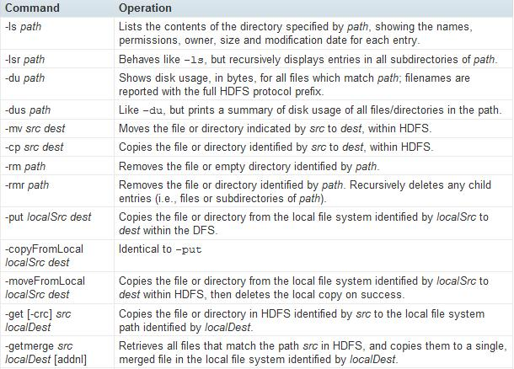
HDFS: Command Line Interface (CLI)

Slide 74
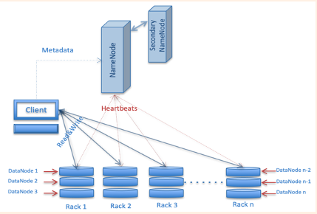
HDFS Architecture

Slide 75
HDFS Components: NameNode
Stores information about metadata and transaction logs
Two metadata files:
One file contains metadata about directories and files
ownership, permissions, quotas, access time, and the replication factor
One file contains a list of transaction logs
file creations/deletions and a series of modifications made to the file system after starting the NameNode
Stored in the main memory, not in secondary storage for faster access
Maintains and manages the blocks, located in DataNodes
Single point of failure (SPOF)for the cluster: the file system goes offline if NameNode is down

Slide 77
HDFS components: Secondary & Standby NameNodes
Used to increase availability & reliability.
Hosted on separate machines
Standby NameNode is used as a master when the master fails
Secondary NameNode:
Connects to the NameNode periodically
Performs a backup operation of the NameNode
When needed, the saved metadata can be used to rebuild a failed NameNode

Slide 78
HDFS Components: DataNodes
Provide the actual storage of files among several machines.
The number of DataNodes can be increased horizontally to accommodate the need for more data storage.
Input files (size of gigabytes, petabytes, or even terabytes) are split into smaller blocks, generally in the size of megabytes and each block is stored in a DataNode
DataNodes Periodically report the list of blocks that they are storing to the NameNode
Occurs via digital signals known as heartbeats
Allows the NameNode to build metadata about the file system
DataNodes respond to read and write requests from the clients

Slide 85
Read and Write Operations in HDFS
HDFS follows a Write Once Read Many (WORM) model
means that once you store the files in HDFS, you cannot edit them
However, you can append data into those files
In both read and write operations, the client first interacts with the NameNode to retrieve file location, then the client interacts with DataNodes for the actual transfer of Data

Slide 86
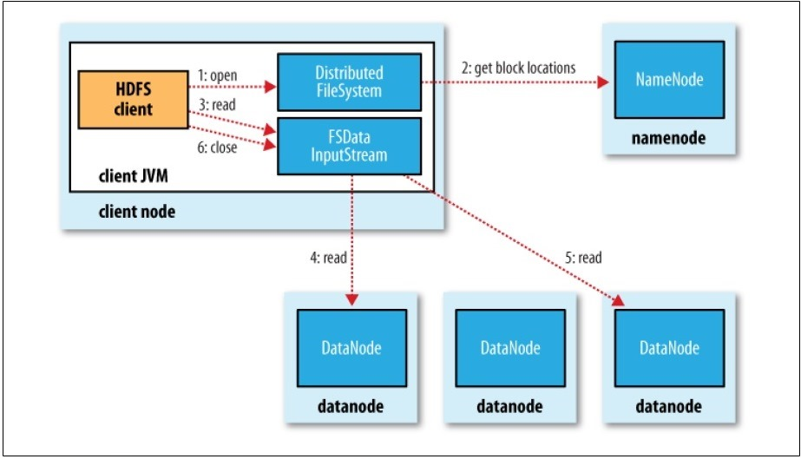
Reading Files from HDFS
Client a request to NameNode with file name
NameNode determines the location of the first few blocks of the file
For each block, NameNode returns the addresses of the DataNodes that have a copy of that block
DataNodes are sorted according to their proximity to the client
Blocks are read in order

Slide 87
Reading Files from HDFS (continued)
The reading process is a Java object of type FSDataInputStream
When a given block ends:
FSDataInputStream closes the connection between the client and the DataNode holding that block
Finds the closest DataNode that holds the next block
If there is an error during the communication or a corrupted block is found, FSDataInputStream attempts to connect with the next closest DataNode that stores the block

Slide 88
Writing a File to HDFS
Client “cuts” input file into chunk of “block size”
Client contact NameNode to request write operation
Send # blocks and Replication Factor
NameNode responds with a pipeline of DataNodes to write first block to
Client reaches out to first DataNode in the pipeline and performs write
2nd and 3rd and all other DataNodes write directly to each other
After final DataNode responds, client is notified of successful block write
Client notifies NameNode of block write
NameNode responds with pipeline of DataNodes to write second block to
Repeat
Last block written
File closed in NamdNode

Slide 89
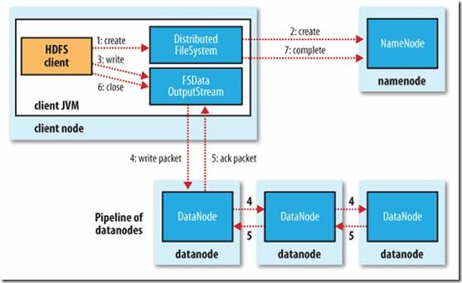
Anatomy of a File Write

Slide 94
Summary of HDFS Characteristics
Stores very large files (TB or PB)
Write-once-read-many (WORM): no updates
Runs on commodity hardware
Does NOT support:
Low latency data access
Lots of small files
Multiple writers or arbitrary file modifications

Slide 95
Important HDFS Concepts
Single NameNode master provides simplicity but Single point of failure (SPOF)
The replica placement algorithm supports fast write and fault tolerance.
Separate data flow from control flow for scalability
Automatic recovery from faults using:
Heartbeats
Re-replication

Slide 96
Why having a Single NameNode Master?
Simplicity: having a Single Master vastly simplifies design
Master node is able to make sophisticated block placement and replication decisions using global knowledge
Master’s involvement on reads and write is minimized.
Metadata size is not that big as Hadoop is designed to store a small number of large files
It may cause a bottleneck for very big clusters

Slide 97
Protocols to reduce drawbacks of SPOF
NameNode recovery is fast
Load namespace image into memory
Replay edit logs
Receive enough block reports from the data nodes
Standby master node:
High availability is supported by making a pair of NameNodes in an active standby configuration.
In case of failure, a standby takes over its duties to continue servicing the client request without a significant interruption
This is different than the secondary name node

Slide 98
What does it mean for two nodes to be “close” to each other?
The limiting factor is the rate at which we can transfer data between nodes (i.e., bandwidth)
Close-by nodes communicate faster with each other which improves the performance of the whole cluster

Slide 99
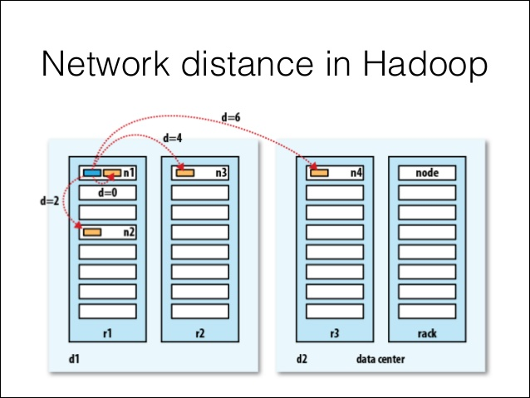
Relative locations | Distance
Same node | 0
Same rack | 2
Same data center | 4
Different data centers | 6

Slide 100
How does the NameNode choose which DataNodes to store replicas on?
Tradeoff between reliability and bandwidth:
Placing all replicas on a single node incurs the lowest write bandwidth penalty but this offers no real redundancy
If a node fails, then the data for that block is lost
Placing replicas away from each other maximizes redundancy (and hence improves reliability) but at the cost of bandwidth.
HDFS’s default strategy:
The first replica is placed on a random node while avoiding full or too busy nodes
The second replica is placed on a different rack from the first chosen at random
The third replica is placed on the same rack as the second but on a different node that is chosen at random.

Slide 101
Example 1 on Storing Data Blocks
File will split into three blocks: B1, B2, and B3
The NameNode assigns the three replicas of B3 as follows:
first copy of B3 → rack 1, node 2
second copy is placed on a different rack→ rack 2, node 4
third replica on a different node but the same rack as the second replica → rack 2 node 5
Figure 3-7: Storing Data Blocks in HDFS

Slide 102
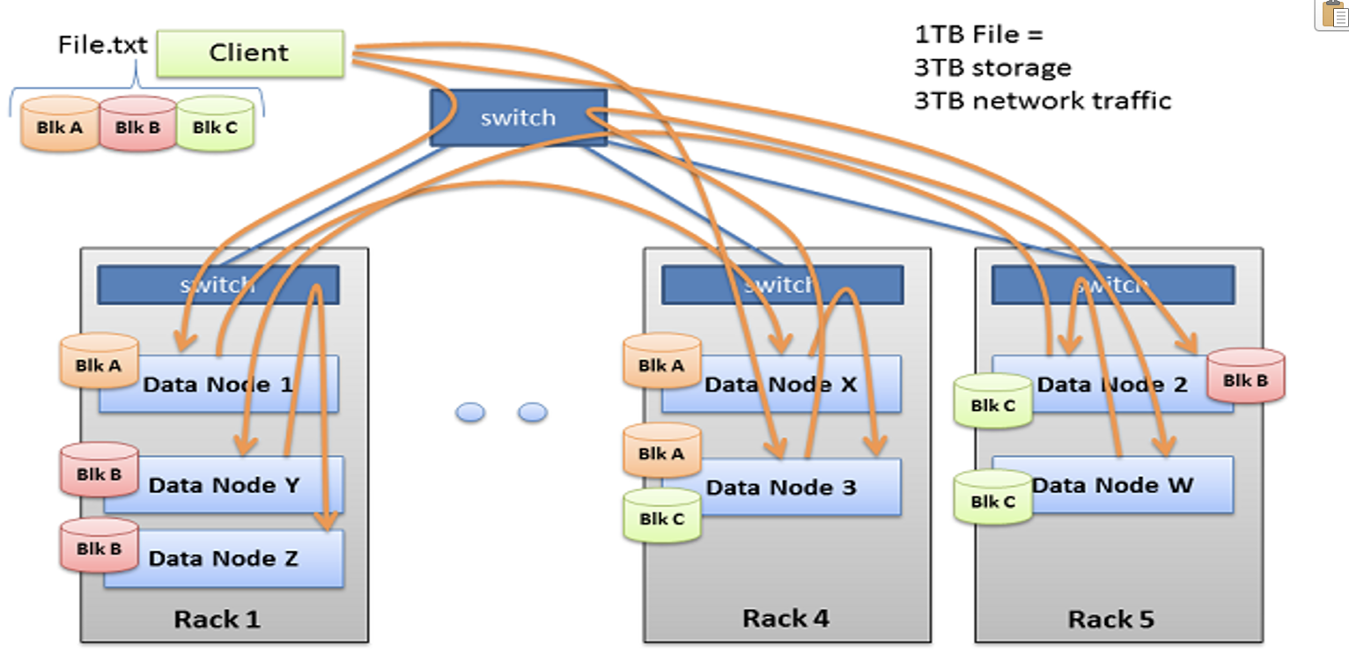
Example 2 on Storing Data Blocks

Slide 103
How Hadoop supports Scalability?
Data flaw is separated from control flaw
Clients contact DataNodes directly to retrieve data and is guided by the NameNode to the best DataNode for each block
This allows HDFS to scale to a large number of concurrent clients because the data traffic is spread across all the data nodes in the cluster
NameNode merely service block location requests and does not serve data

Slide 104
Automatic fault recovery via Heartbeats
Each DataNode sends a Heartbeat message to the NameNode periodically.
A network partition can cause a subset of DataNodes to lose connectivity with the NameNode.
The NameNode detects this condition by the absence of a Heartbeat message.
The NameNode marks DataNodes without recent Heartbeats as dead and does not forward any new IO requests to them.
Any data that was registered to a dead DataNode is not available to HDFS anymore.

Slide 105
Re-Replication
The NameNode constantly tracks which blocks need to be re-replicated and initiates replication whenever necessary.
The necessity for re-replication may arise due to many reasons:
a DataNode may become unavailable,
a replica may become corrupted,
a hard disk on a DataNode may fail,
or the replication factor of a file may be increased.

Slide 106
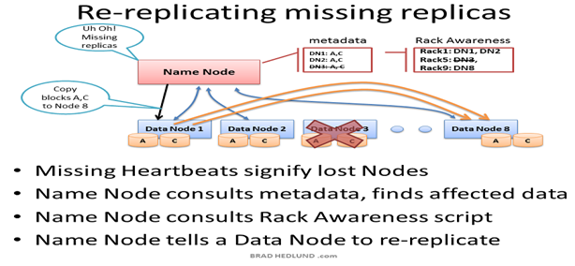
What happens wehn a DataNode fails?

Slide 107
Summary of HDFS design decisions
Scalability → data flow is separate from control flow
Fault tolerance →
Block replication (to handle salve disk failure)
Standby master (to handle master node failure)
Heartbeats & re-replication (to handle for slave node failure)
reliability →
Replicating each file block
Choosing replica locations on different racks if possible.

Slide 108
The MapReduce Programming Paradigm

Slide 109
MapReduce’s Paper Abstract
MapReduce is a programming model and an associated implementation for processing and generating large data sets.
A MapReduce program is written as two functions:
Map function: processes a key/value pair to generate a set of intermediate key/value pairs
Reduce function: merges all intermediate values associated with the same intermediate key

Slide 110
Why using MapReduce?
Programs written in this functional style are automatically parallelized and executed on a large cluster of commodity machines.
The runtime system takes care of the details of:
Partitioning the input data
Scheduling the program’s execution across a set of machines
Handling machine failures
Managing the required inter-machine communication
This allows programmers without any experience with parallel and distributed systems to easily utilize the resources of a large distributed system.

Slide 113
The MapReduce: graph next slide
InputFormat: decides how the file is going to be broken into smaller pieces for processing using the InputSplit function.
A Record Reader is then assigned to transform the raw data for processing by the Map.
The Map then uses two inputs (Key and Value) to process the data
The Map produces output, basically a list of data with a key, the output pair.
The Partitioned data from the Map is Shuffled and Sorted for input
into the Reducer.
The Reducer combines or reduces the input data into another output
pair (Key and Value) according to the rules of what is being asked.
(i.e. how many times does a URL appear in a search)
The output from the Reducer is formatted by the Output Formatter
organizes the Reducer output so it can be written to HDFS.
Data is written to HDFS

Slide 115
A MapReduce program is written as two functions:
Map function: processes a key/value pair to generate a set of intermediate key/value pairs
Reduce function: merges all intermediate values associated with the same key

Slide 116
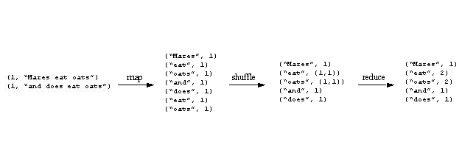
Example 1:
Word Count:
It’s the “Hello World” of MapReduce
Assume you have a huge amount of text documents.
It is required to find how many times each word appears.

Slide 123
Word Count Pseudo Code
map(String key, String value):
//key: document name
//Value: document contents
for each word w in value:
emit(w,”1”);
reduce(String key, Iterator values):
//key: a word
//Value: a list of counts
int result = 0;
for each v in values:
result += ParseInt(v);
emit(AsString(result));

Slide 124
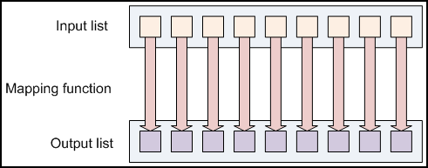
Map Function
A Map function takes as input a list and operates singly upon each individual element in the list.
The mapper receives a list of key value pairs and is expected to output a zero or more key/values.

Slide 125
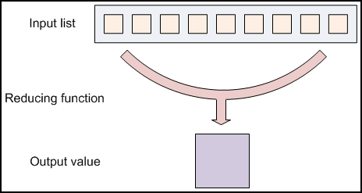
Reduce Function
A reducer also takes a list as input, but then combines the values in the list to a single output value.
Hadoop reducers receive that list of values on a per-key basis via the key/value pairs the mapper output.

Slide 126
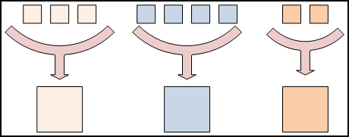
Reduce Function (continued)
Different colors represent different keys.
All tuples with the same key values are forwarded to the same reduce task

Slide 127
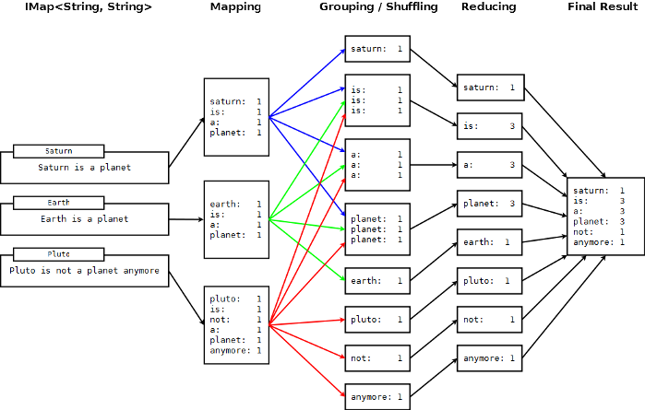

Slide 128
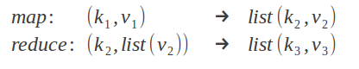
Key/Value Pairs
The input keys and values are different than the output keys and values
The reducer’s input keys and values are the same as the mapper’s output keys and values

Slide 129
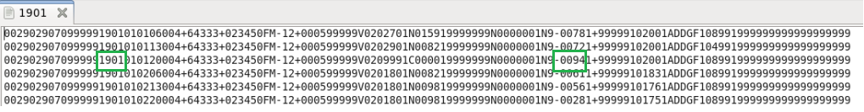
Example 2: Max Temperature
Data from NCDC (National Climate Data Center)
Query: what is the highest recorded global temperature for each year in the dataset?
Each line has many recorded data elements
We will focus only on the year and temperature elements.

Slide 130
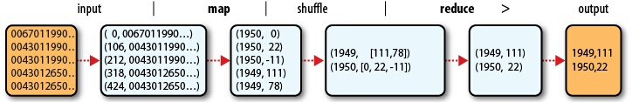
Example 2 (continued)
map function extracts the year and temperature from each line:
(1950,0), (1950,22), (1950,-11), (1949,111), (1949,78)
shuffle sorts and groups the data:
(1949,[111,78])
(1950,[0,22,-11])
reduce function finds the maximum for each year:
(1949,111)
(1950,22)

Slide 131
Max Temperature Pseudo Code
map(String key, String value):
//key: line number
//Value: one line from the data file
Parse the input line and extract
Year at positions (15 to 19)
Temperature at positions (88 to 92)
emit(year,temperature);
reduce(int year, Iterator values):
//key: a word
//Value: a list of counts
maxtemp = none;
for each v in values:
if value > maxtemp
maxtemp = value
emit(year,maxtemp);

Slide 132
Python Implementation of Mapreduce

Slide 133
Steps in Lab 9
Preparing the Mapper and Reducer Python files
Testing the job locally to make sure it produced the correct output
Running the job on a Hadoop cluster on the cloud → Lab 9
Notes:
Source: https://www.michael-noll.com/tutorials/writing-an-hadoop-mapreduce-program-in-python/

Slide 134
Word Count

Slide 135
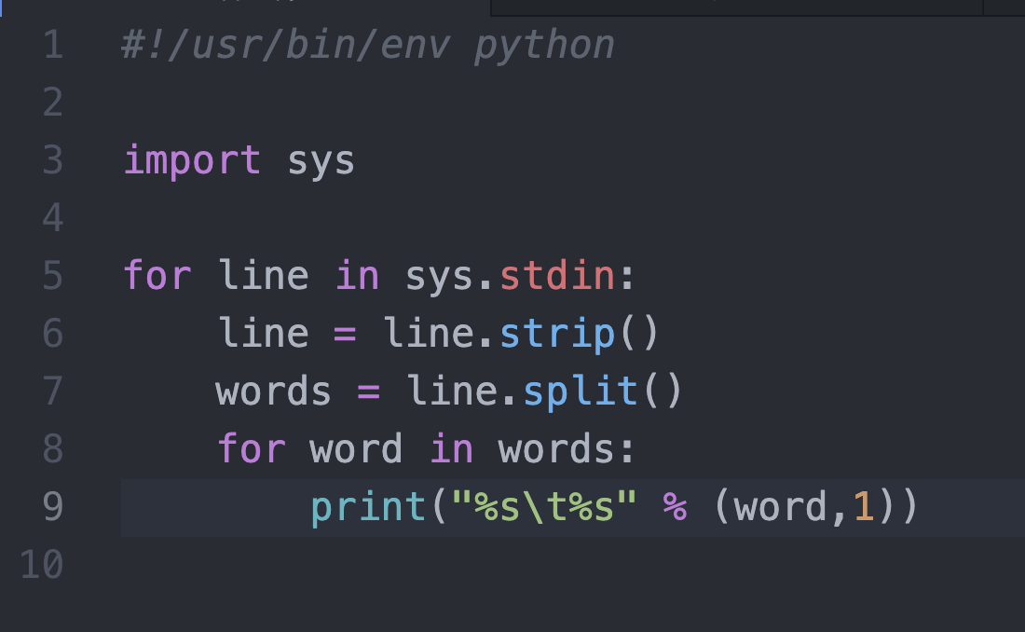
WordCountMapper

Slide 136
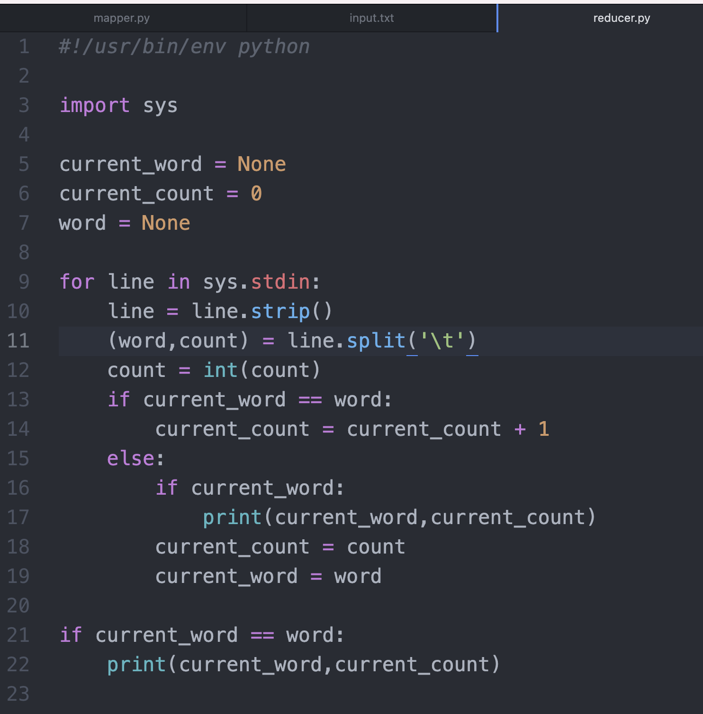
WordCountReducer

